Slide 1
Zen of Data
Day 1
The Data Bootcamp |
5/2/18
Notes:
Alright, welcome everyone, nice to meet you all. My name is Julien and I’m a guest speaker for today’s intro class.

Slide 2
Quick Introductions! (30 seconds)
Name
Where From?
Background (Career, Education, Interests)
Why are you here?
Notes:
We’re going to start this class by having every one of you introduce themselves.
We’re going to spend a lot of time together in the next six months. it’s very important that we get to know each other and that we build a community.
So let’s hear a little bit about you. Briefly tell us your name, where you’re from, what’s your background and what are your goals for this class, why are you here?

Slide 3


TAs
Ahmed
Sufyan

Slide 4

About me
Julien Spronck
From Belgium
Background in Optics, Physics Engineering and Astronomy
Love teaching and learning
Love programming, web design
Love the outdoors (hiking, climbing, running, …)
YOUR PHOTO
GOES HERE

Slide 5
Things I’ve Worked On…
MASCARA: Multi-site All-Sky CAmeRA
20 000 000 images
over 1 billion data points
Process, analyze, visualize all data to discover trends,
patterns => scientific discoveries

Slide 6
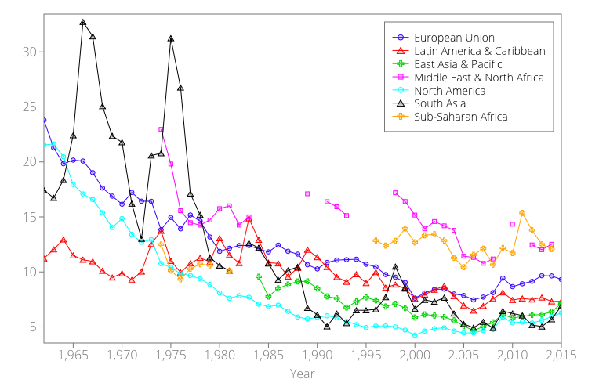
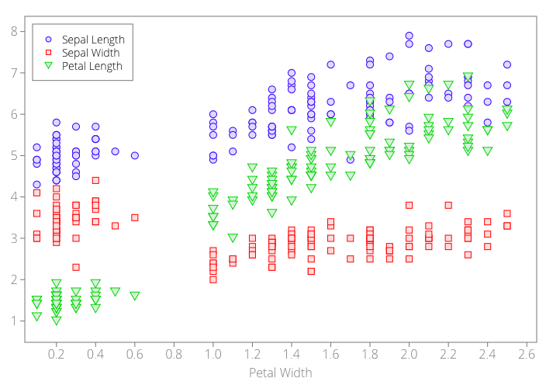
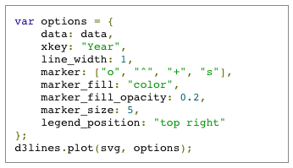
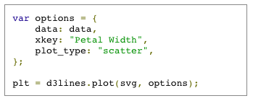
Things I’ve Worked On…
d3lines.js

Slide 7
The Rise of Data
Notes:
Before we move on to the course overview, let’s talk a little bit about data. After all, that’s what you’re all here for.

Slide 8
Question: Why is “data” such a hot skill these days?
Notes:
So, why do you think data science or data analysis is such a hot topic these days?

Slide 9
1. Explosive Growth in “Digitized” Data (Creation)
Notes:
Explosion of digital data created in recent years, because we generate a lot of data with our devices, the internet. These days, a lot of things that we do is digitized and transformed into data.

Slide 10
2. Explosive Growth in Analytic Tools (Synthesis)
Notes:
The second thing is, we have better tools that we used to to analyze all of the data generated: Python modules, Hadoop, D3.js. There are a lot of tools that have been specifically built to handle and analyze large data sets and to discover trends and patterns. We also have more powerful computers that allow us to can handle all of that.

Slide 11
3. Accelerating Search for Actionable Insight (Value)
Notes:
The third reason is that recently, a lot of company realized that data has value.
What do you think makes data valuable to business?
Decision making
Targeting and personalization
?

Slide 12
Data Means What?
Notes:
It’s important to keep in mind why you joined this class. Let’s talk about your goals.

Slide 13
So… What is data science?
Notes:
So, what is data science? What is the first image that comes to mind when hearing the words data science?

Slide 14
First Thoughts…
Notes:
Statistics or mathematical models

Slide 15
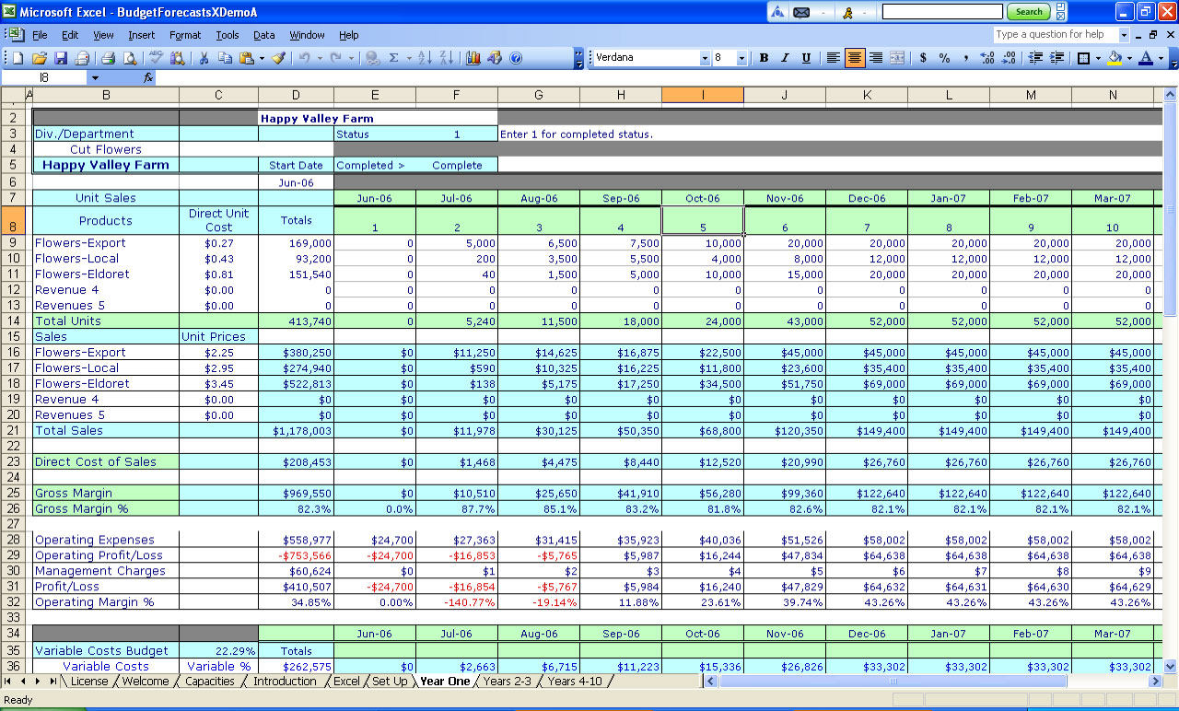
First Thoughts…
Notes:
Spreadsheets

Slide 16

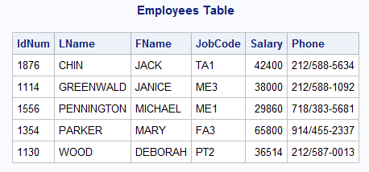
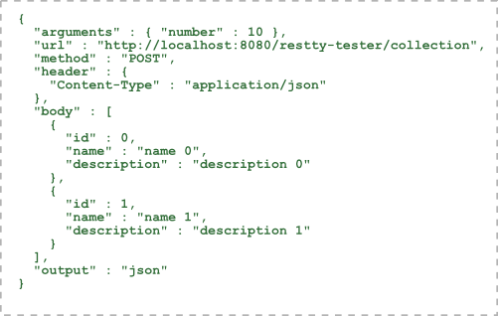

First Thoughts…
Notes:
Databases

Slide 17
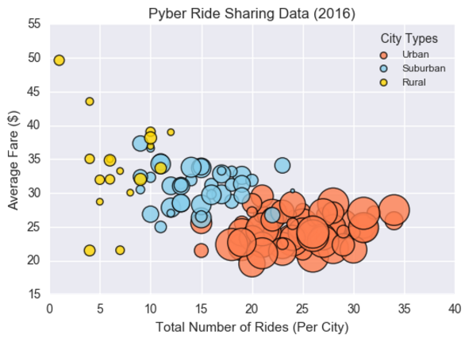
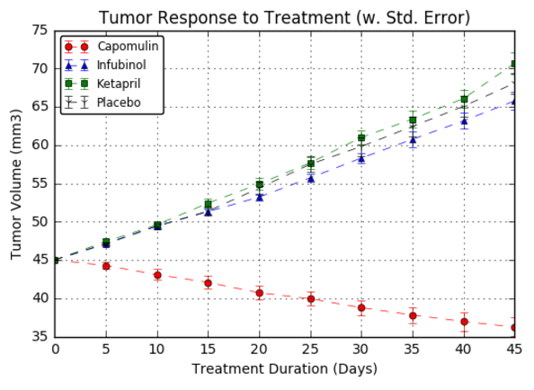

First Thoughts…
Notes:
Graphs and visualizations

Slide 18
Data Science centers on two things:
Notes:
These are all very important aspects of data science that we will talk about throughout this course but fundamentally, data science is about two different concepts: fundamentally, data science is about story-telling and truth telling.

Slide 19
Truth-Telling & Story Telling
Notes:
A lot of the times, data scientists focus on the numbers and on the tools but lose sight of what really matters: which is trying to understand something and communicate your findings. There is always a fundamental reason why you’re looking through some data, you don’t do it for the love of spreadsheets, you do it to answer a question, to discover something and to tell a story.

Slide 20
Truth-Telling
Notes:
So let’s talk about truth telling. What we mean is that data allows us to know how the world is (retrospective analysis), how the world will be (predictive analysis) and how the world could be (modeling). There is truth to data.

Slide 21
Data As… Truth-Telling
Unearthing relationships
Notes:
If I show you this graph that shows the number of cigarettes smoked and the number of lung cancer deaths as a function of years. This data is true, it tells us something true about our world today. And you can’t dismiss that.

Slide 22
Data As… Truth-Telling
Making Predictions
Notes:
It might also tell us something about the future. When we use data to predict where a stock is headed, we’re trying to tell the truth about the future.

Slide 23
Data As… Truth-Telling
Stating Significance
Notes:
We can also compare data to a certain model, to understand what is true and what is not. In essence, data analysts need to be well versed in understanding what's true from what's false, and they use data to make these determinations.

Slide 24
Story-Telling
Notes:
The second thing that’s very important and is often ignored is story-telling.

Slide 25
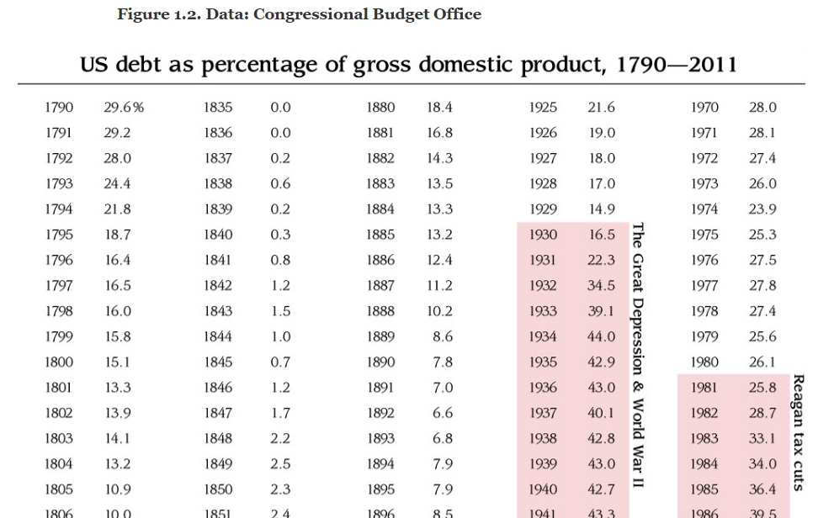
Data As… Story-Telling
Notes:
Data can be meaningless, so this is … and it looks meaningless. But if you spend the time and organize that data another way, you can start seeing a story unfold.

Slide 26
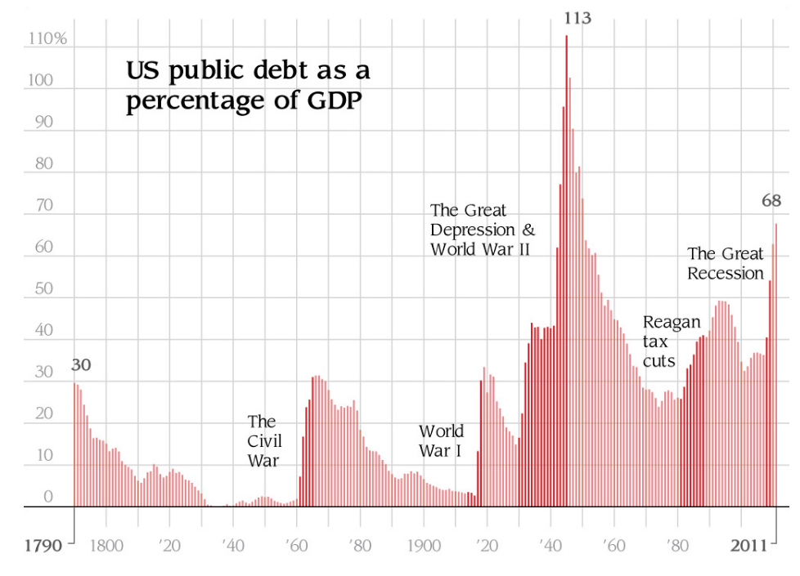
Data As… Story-Telling
Notes:
As data analysts, your job will also be to communicate your results, you will need to create a narrative, the story of the data they are analyzing. Data as story telling has become a very important part of media these days.

Slide 27
Course Overview
Notes:
Data analysis and data science are not exact sciences. There isn't a linear pathway to becoming a data professional. Instead, to be a good data analyst requires being well-versed in a variety of tools, technologies, approaches, and strategic processes. In this class, you will learn how to use many of these tools. You will create your own tool belt.

Slide 28
Tools for Truths, Skills for Stories…
Our Goals
Truth-Telling
Story-Telling
Our Means
Microsoft Excel
Python
Pandas
Tweepy
VADER
Matplotlib / Seaborn
APIs
Beautiful Soup
Machine Learning
MySQL
MongoDB
HTML / CSS
JavaScript
D3.js
Leaflet.js / Google Maps
CartoDB
Tableau
Hadoop
Notes:
In this program, we will try to focus on truth telling and story telling and we will use a variety of means to do that. We will use tools like Excel, Python, MySQL, … But we will always use this tools with the goals of truth telling or story telling.
So, to get a sense of what people are familiar with, raise your hand if you ever worked with Python? What about JavaScript? Cool.
So, by the end of this program, you will all have a pretty good set of tools under your belt and that will make you very competitive.
These tools fall in four different categories: Programming languages, Statistical methods, Data storage/retrieval and reporting capabilities.

Slide 29
Daily Routine
For each class we’ll run through the following:
Set Objectives
Brief Background Lecture
Watch Me / Coding Demos
Code Discussions
In-Class Exercises
Project Work
Notes:
What we will be doing on a daily basis will be rather different than what we’re doing today. Today, I’m spending a lot of time monologuing and lecturing. But in the rest of the program, you’ll be doing most of the work. Typically, I’ll give a brief lecture at the beginning of class, I’ll show you some quick demos and the rest of the time, you’ll spend it on exercises, discussions and project.

Slide 30
Daily Routine
For each class we’ll run through the following:
Set Objectives
Brief Background Lecture
Watch Me / Coding Demos
Code Discussions
In-Class Exercises
Project Work
The Super Important Stuff!!!
i.e. Always be doing!
Notes:
That’s really the heart of this program. A lot of programs are very passive and by the end of the day, you don’t necessarily learn much. In this program, we will really focus on being as active as possible. You’ll learn by doing.

Slide 31
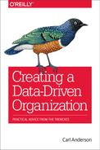
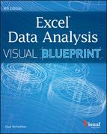

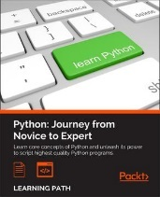
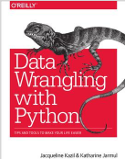

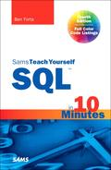
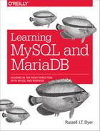


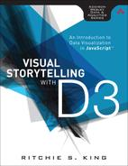

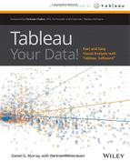
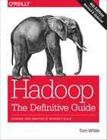
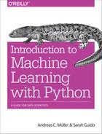
Curriculum At-A-Glance
Weeks 1-2: Intro to Data Analytics & Excel Masters Students begin the course with an introduction to the high-level concepts of data analytics and real-world data crunching with Excel Formulas, Pivot Tables, and Conditional Formatting.
Weeks 3-9: Python Data Analytics and Visualization Next, students are given a thorough crash-course on Python programming, followed by multiple weeks of data processing using advanced libraries like NumPy, Pandas, Matplotlib, Seaborn, Tweepy, and Beautiful Soup.
Weeks 10-12: Deep Dive into Databases Students then immerse themselves in three-weeks of introductory and advanced work with SQL (MySQL and Postgresql) and noSQL databases (MongoDB).
Weeks 13-17: Web Based Data Visualization Students then complete a series of rigorous weeks introducing them on the fundamental tools of web-development (HTML, CSS, JavaScript) and advanced libraries useful for data visualization (D3.js, Leaflet.js)
Weeks 20-24: Final Projects & Advanced Topics
Finally, students complete the program by developing a “real-world” data visualization project that applies all they’ve learned. During this time student will be introduced to advanced topics like Tableau, Hadoop, Machine Learning, and R.
Notes:
So, here’s an overview of what we’ll be doing in the coming months.
We’ll be spending a couple weeks on Excel and VBA. For some of you, this will be easy.
Then, we’ll spend a lot of time on Python and Pandas.
We’ll dive into databases, like MySQL and MongoDB.
Then, we’ll talk about JavaScript and web-based data visualization.
Finally, we’ll cover some advanced topics like Hadoop, Tableau, Machine Learning and will work on final projects.
If all of this feels a little bit overwhelming, remember that we’ll do this one day at time and we’ll learn one tool at time.

Slide 32
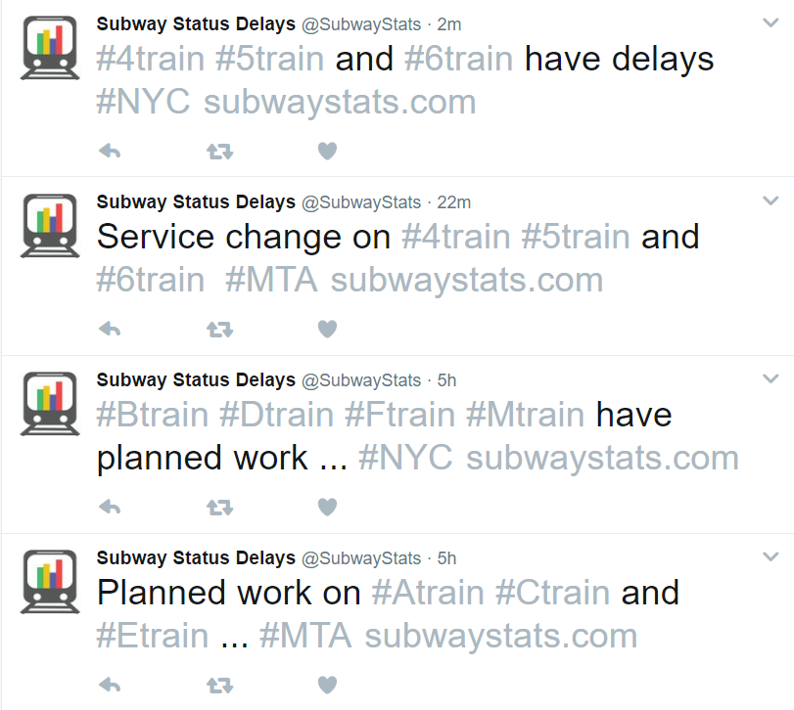
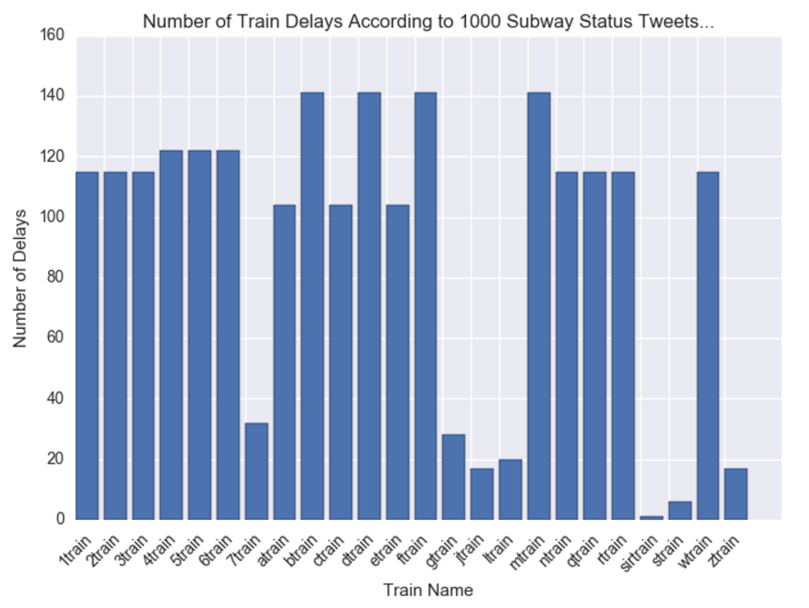
Example Activity: Subway Delays… According to Twitter
We’ll utilize Twitter Data online to assess which NYC trains are most likely to be delayed. We will be using Python Pandas, Tweepy, Twitter’s API, and Matplotlib to convert tweet data into meaningful graphs.

Slide 33
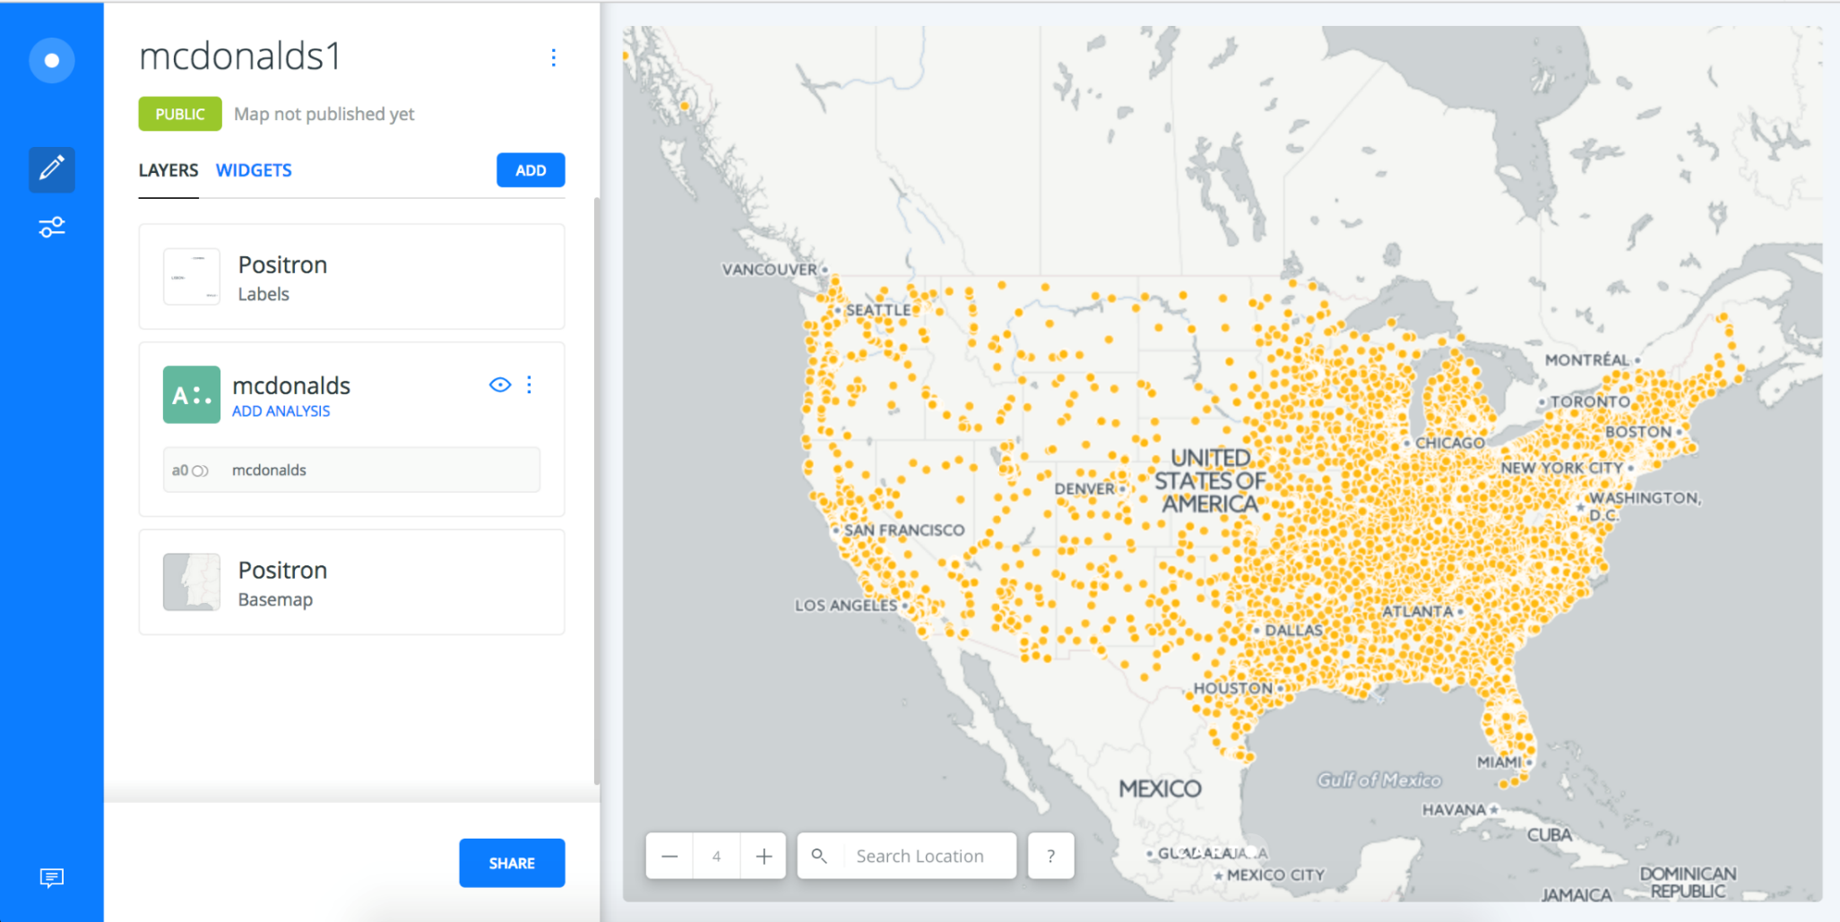
Example Activity: McDonalds Map (Carto)
We’ll be using publicly available data to create interactive dashboards of all McDonalds across the country using easy-to-use visualization tools like Carto.

Slide 34

Example Activity: Banking Deserts
And we’ll be using a variety of public demographic data and APIs to explain many real-world social phenomena.

Slide 35
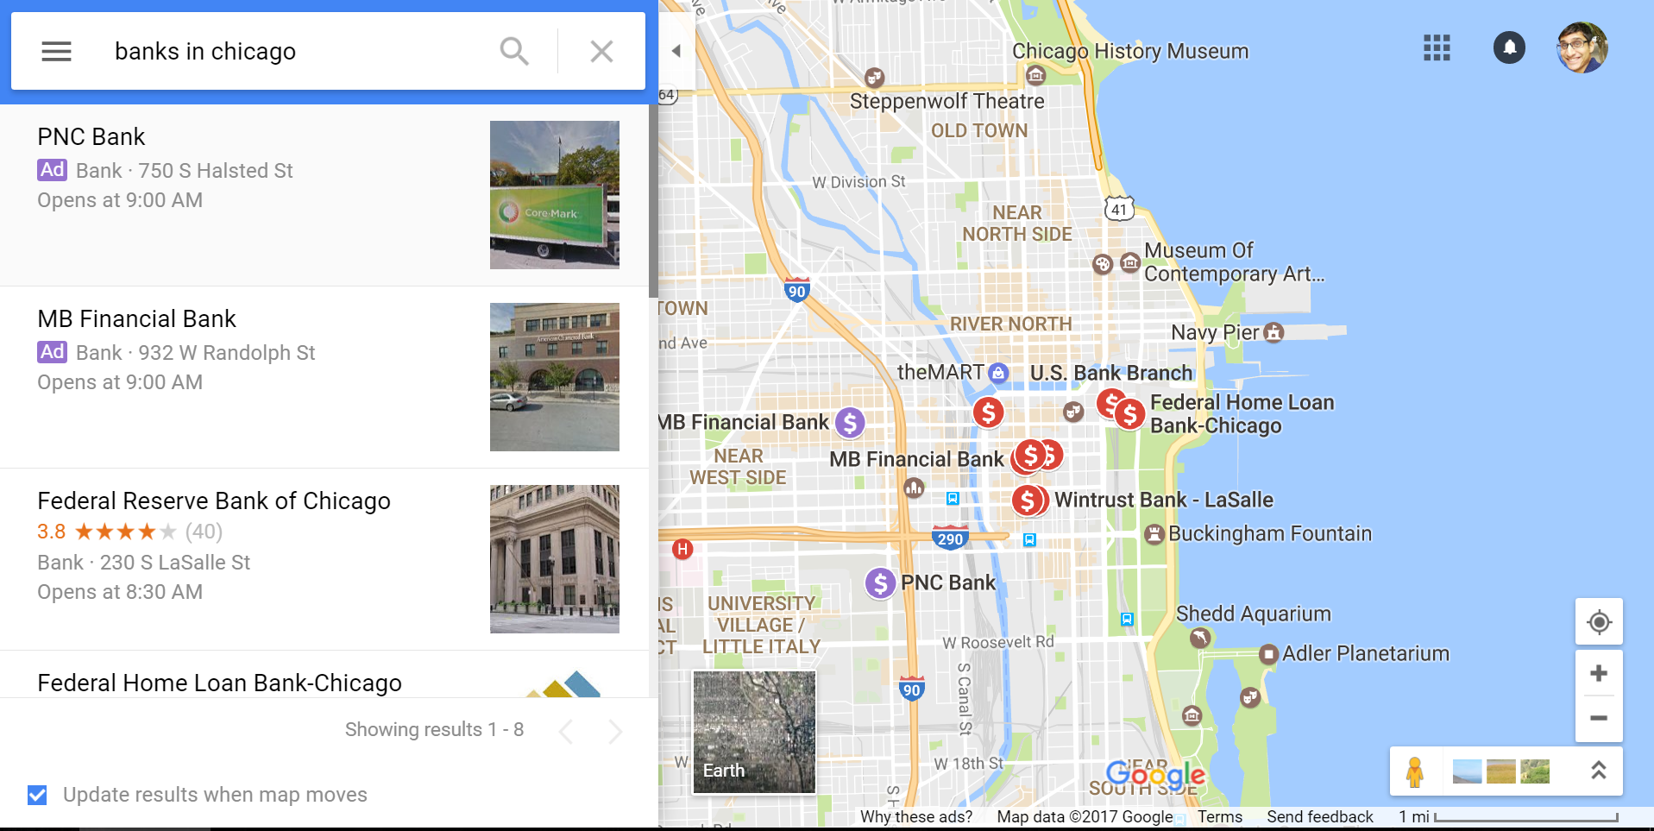

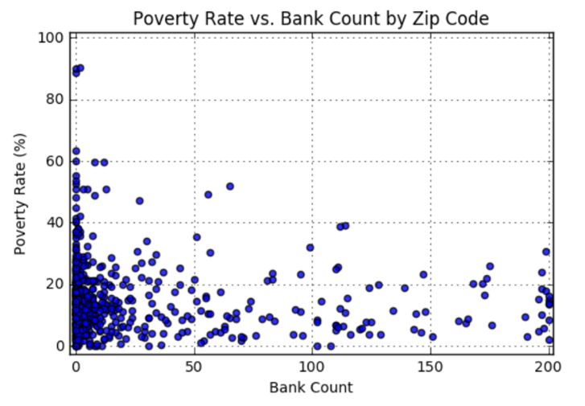
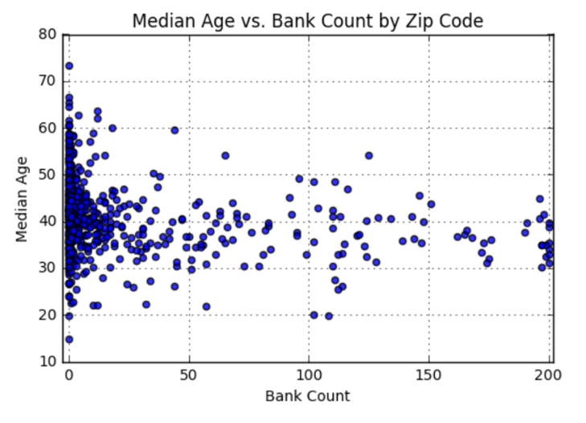
Example Activity: Banking Deserts
We’ll be utilizing data from sources like the US Census, Google Maps, and more to dredge out insights on poverty, discrimination, and the impact of changing economies.

Slide 36
We’ve got a long ways to go…
Notes:
We have a long ways to go. If all of this is a little bit overwhelming, remember that we’ll do this one day at time and one tool at time.
It’s not going to be easy but you will learn a lot and hopefully, you’ll also have fun along the way.

Slide 37
Helpful Tips

Slide 38

1. Embrace Your Inner Toddler
Notes:
Embrace your inner toddler: don’t be afraid to be a beginner. You’re here to learn right? So, it’s okay not to know something. In fact, admitting that you don’t know something will allow you to invest the time necessary to succeed. Humility is the first requirement to be successful in this program. The only things that will guarantee success are hard work, humility, and a relentless desire to be better.

Slide 39

2. Brace Yourself for Doubt, Challenge, and Confusion
Notes:
It’s going to be tough. Data analysis is hard, coding is hard. It will take time and there is no way around it, you gotta work hard. Sometimes, you will have doubts.

Slide 40
2. Brace Yourself for Doubt, Challenge, and Confusion
“You can’t tell whether you’re learning something when you’re learning it—in fact, learning feels a lot more like frustration.”
“What I’ve learned is that during this period of frustration is actually when people improve the most, and their improvements are usually obvious to an outsider. If you feel frustrated while trying to understand new concepts, try to remember that it might not feel like it, but you’re probably rapidly expanding your knowledge.”
Jeff Dickey, Author of Write Modern Web Apps with the MEAN Stack: Mongo, Express, AngularJS, and Node.JS
Notes:
But the thing is, every data scientist and every software engineer started somewhere and were beginner at some point. And now, they’re data analysts. It takes time but you have what it takes. I know that you do.

Slide 41
3. Relish the Novice Experience
Expect a lot of lightbulb moments
Notes:
Sometimes, it will be frustrating because things don’t work or maybe you’ll feel overwhelmed. I think it’s part of the process. I think this feeling is basically your brain telling you: oh wow, that’s a lot to absorb, I need a little time to digest this and put some order into things. I really think that feeling is a necessary step before any lightbulb moment, where all pieces of the puzzle finally click together. So, don’t worry about those times where you feel frustrated. There will be a lot of those times. And that’s okay. Just know it’s coming. And just know that there will also be a lot of victories along the way and a lot of light bulb moments.

Slide 42
4. Form a Community Now!
Your
Classmates
Notes:
What’s going to very important in this class is the community that we will be forming. You, Shani, your Tas and your instructor , you will be spending a lot of time together. We’re like a big family embarking on a long journey. We’re in this together. Your victories are every one’s victories. When you have a hard time, we will have a hard time too. And when you will think something is easy, well maybe the rest of us will still have a hard time. The TAs and I will be there every step of the way to help you but mostly, we need you guys to help each other. We need guys to motivate each other and being there for one another. Because, nobody else in the world will understand better what you’re going through than the rest of us. So, my advice is let’s be an awesome family.

Slide 43
5. Put in the Hours (And the Effort)!
There is no “magic pill”. You’ve got to put in the hours!
Notes:
Put in the hours.

Slide 44
6. Celebrate Your Successes!
Notes:
Celebrate your successes. Constantly remind yourself of all the things that you learned and how much progress that you made. Focusing on the successes can be very helpful.
Any question until now?

Slide 45
It’s time for a group activity!

Slide 46
Form a group of 3-4 students. (Psst… There shouldn’t be someone right next to you)

Slide 47
Break!
Notes:
It’s important to keep in mind why you joined this class. Let’s talk about your goals.

Slide 48
Thought Experiment #1
The Great Debate
Notes:
It’s important to keep in mind why you joined this class. Let’s talk about your goals.

Slide 49
Imagine… Your entire bonus rests on answering this next question.

Slide 50
Or if you want something higher stakes... Imagine Your entire life depends on answering this question…

Slide 51


The Question…
Which do Americans prefer:
Italian or Mexican food?

Slide 52
> YOUR TURN!
Activity: The Great Debate | Suggested Time: 15 min
Assignment:
With your group develop a complete strategy for answering this question with as much confidence possible. Specifically, answer questions like:
What data will you attempt to gather?
What relationships will you be looking for?
How will you ensure your answer is most likely “true”?
Assumptions:
You are given 5 hours and a budget of $10 to accomplish this.
Your answer will be tested by randomly selecting 9 Americans who will each be asked the question – with 0 qualifiers.
You only have your team.
Be prepared to share! (P.S. Your answer had better not be: “We Googled it”)

Slide 53
Thought Experiment #1
The Great Debate (Analyzed)
Notes:
It’s important to keep in mind why you joined this class. Let’s talk about your goals.

Slide 54
Step 1: Decompose the Ask

Slide 55
Step 1: Decompose the “Ask”
Which do Americans prefer:
Italian or Mexican food?

Slide 56
Step 1: Decompose the “Ask”
Which do Americans prefer:
Italian or Mexican food?

Slide 57
Step 1: Decompose the “Ask”
Which do Americans prefer:
Italian or Mexican food?
Questions it Raises:
Who exactly is an American?
Are Americans just white, forty-year old males?
Do Americans just live in big cities?
Are Americans just millennials?
Obviously not. So, how can we get a representative sample of Americans?

Slide 58
Step 1: Decompose the “Ask”
Which do Americans prefer:
Italian or Mexican food?

Slide 59
Step 1: Decompose the “Ask”
Which do Americans prefer:
Italian or Mexican food?
Questions it Raises:
How do we define “preference”?
Do people prefer the foods they eat most frequently?
Do people prefer the foods they wish they could eat if cost was not an issue?
How uniform is the preference? Is it regionalized? Is it different by demographic?
Inherently, preference is subjective. We are going to need to make it objective.

Slide 60
Step 1: Decompose the “Ask”
Which do Americans prefer:
Italian or Mexican food?

Slide 61
Step 1: Decompose the “Ask”
Which do Americans prefer:
Italian or Mexican food?
Questions it Raises:
How do we categorize foods? Is Pizza Italian? Is Taco Bell Mexican?
How do we categorize food? Does making pasta at home constitute Italian? Or are we just talking about restaurants?
Are we just talking about “best experiences?” Or are we including poorer renditions of these foods?
These are broad categories we are pursuing. We will have to narrow the scope.

Slide 62
Step 2: Identify Data Sources

Slide 63
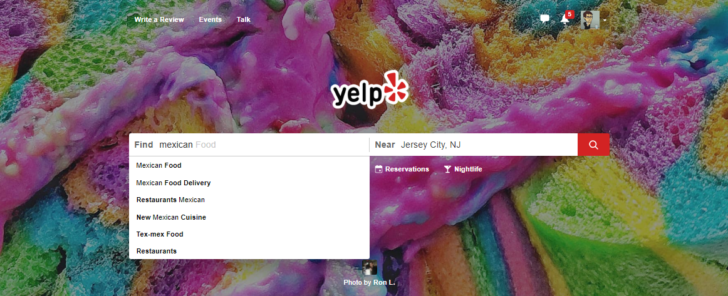
Step 2: Identify Data Sources
As everyday consumers, we are regularly getting a pulse of everyday American food preferences to inform our own decisions. Perhaps we can make use of the same approach?

Slide 64
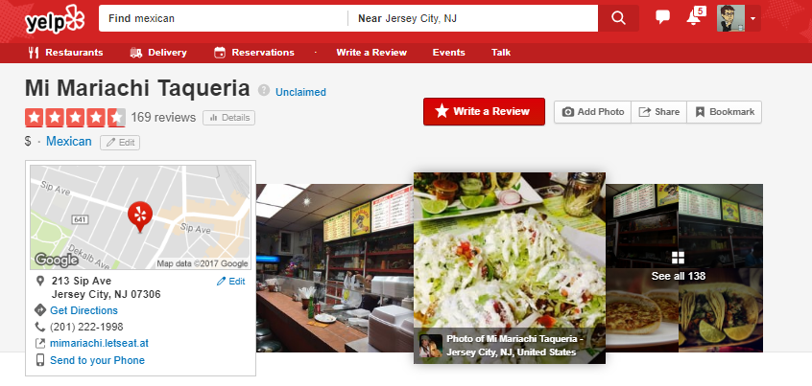
Step 2: Identify Data Sources
Accessing a web service like Yelp provides an almost encyclopedic amount of information on the eating preferences of Americans.

Slide 65

Step 2: Identify Data Sources
Why poll an audience, when there already exist enormous databases of information on American food preferences – readily available online?

Slide 66
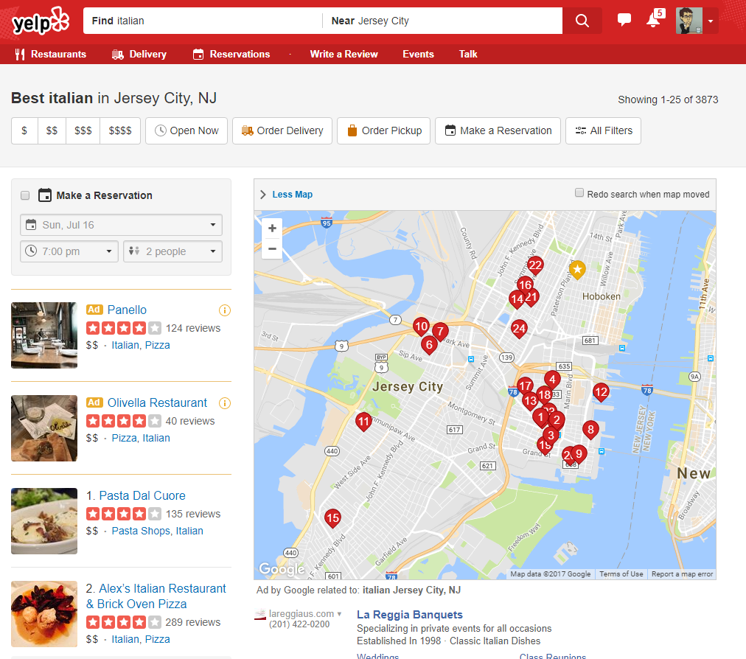
Step 2: Identify Data Sources
Food Type
Location
And LOTS of Data!!
Review Counts
Ratings
Thank you Yelp!!!!

Slide 67
Step 3: Define Strategy and Metrics

Slide 68
Step 3: Define Strategy and Metrics
Here we created a blueprint for what we’re targeting:
Americans:
Ideally we need thousands of records from Americans in hundreds of different cities. (Large samples)
Preference:
Number of Yelp Reviews (More = Preference)
Average Aggregated Ratings (Higher = Preference)
Italian and Mexican Food:
Top 20 Italian and Mexican restaurants in every city.

Slide 69
Step 3: Define Strategy and Metrics
New York
Tucson, AZ
Washington, DC
Italian
Mexican
Italian
Mexican
Italian
Mexican
Restaurant
Restaurant
Restaurant
Restaurant
Restaurant
Restaurant
Restaurant
vs
Restaurant
Restaurant
vs
Restaurant
Restaurant
vs
Restaurant
Restaurant
Restaurant
Restaurant
Restaurant
Restaurant
Restaurant
Restaurant
Restaurant
Restaurant
Restaurant
Restaurant
Restaurant
Restaurant
Restaurant
Restaurant
Restaurant
Restaurant
Restaurant
Omaha, NE
San Diego, CA
Atlanta, GA
Italian
Mexican
Italian
Mexican
Italian
Mexican
Restaurant
Restaurant
Restaurant
Restaurant
Restaurant
Restaurant
Restaurant
Restaurant
Restaurant
Restaurant
Restaurant
vs
Restaurant
vs
Restaurant
vs
Restaurant
Restaurant
Restaurant
Restaurant
Restaurant
Restaurant
Restaurant
Restaurant
Restaurant
Restaurant
Restaurant
Restaurant
Restaurant
Restaurant
Restaurant
Restaurant
Restaurant
Repeat this analysis for as many cities as possible…

Slide 70
Step 4: Build Data Retrieval Plan

Slide 71

Step 4: Data Retrieval Plan
We could brute force our way to retrieve this data, but…
It would be extremely time consuming
It would be skewed by our city familiarity
It would be manually labor intensive

Slide 72
Step 4: Data Retrieval Plan
Basically… Not in a million years.

Slide 73
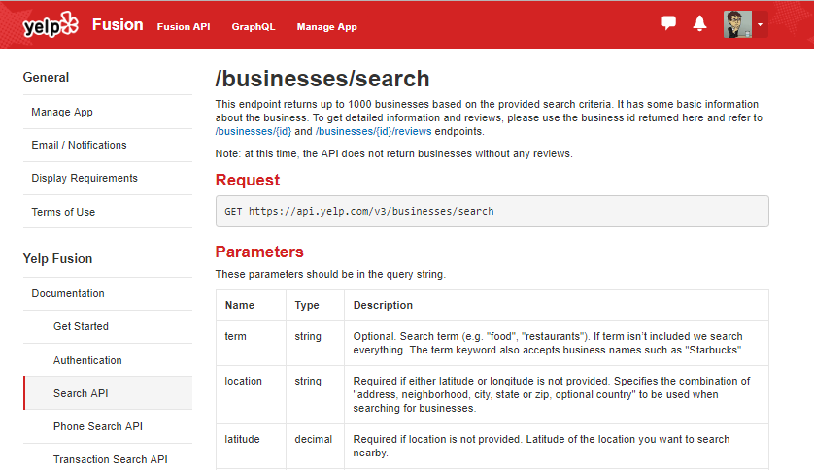
Thank You Yelp!
Thankfully, we can take advantage of the Yelp Fusion API to programmatically run our queries. (#ThankGodForProgramming)

Slide 74
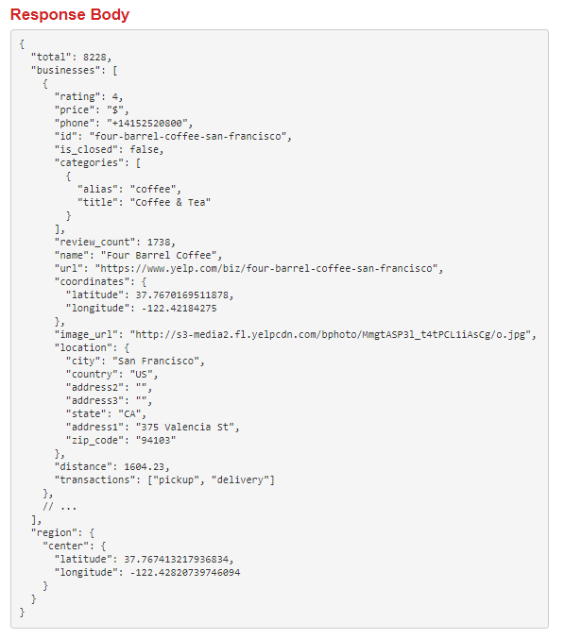

Thank You Yelp!
Thankfully, we can take advantage of the Yelp Fusion API to programmatically run our queries. (#ThankGodForProgramming)

Slide 75


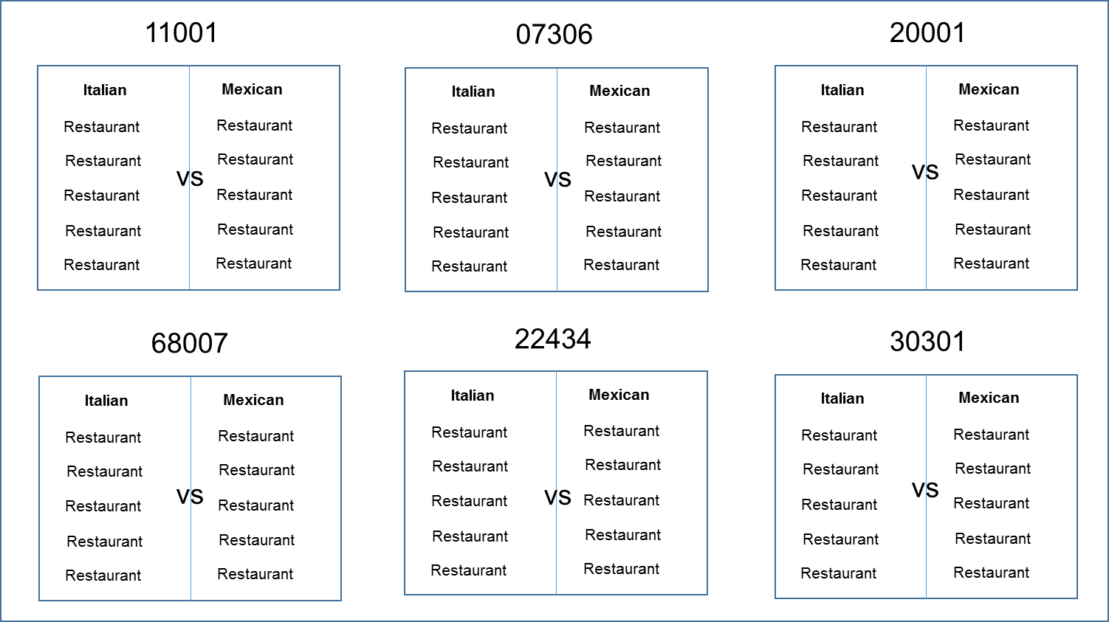

Step 4: Build Data Retrieval Plan
We will build a Python script to randomly select over 700 zip codes from the US Census and then acquire review data from the top 20 Mexican and Italian restaurants for each zip codes using the Yelp API.

Slide 76
Step 5: Retrieve the Data

Slide 77


Pulling with Python
Randomly Select a Zip Code
Create an API Request
Save the Output to a Data Frame

Slide 78
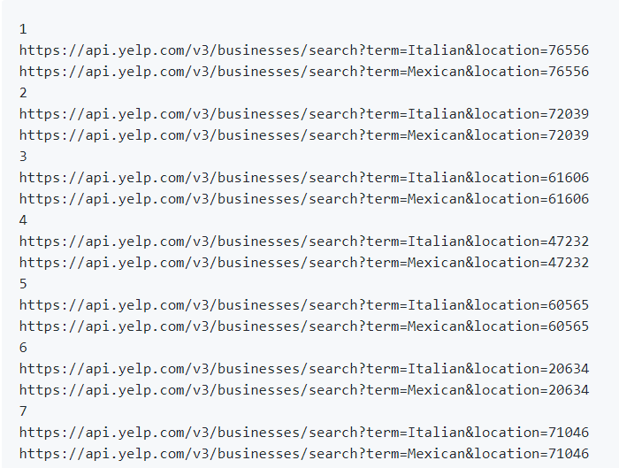
Pulling with Python
Will make all these URLs

Slide 79
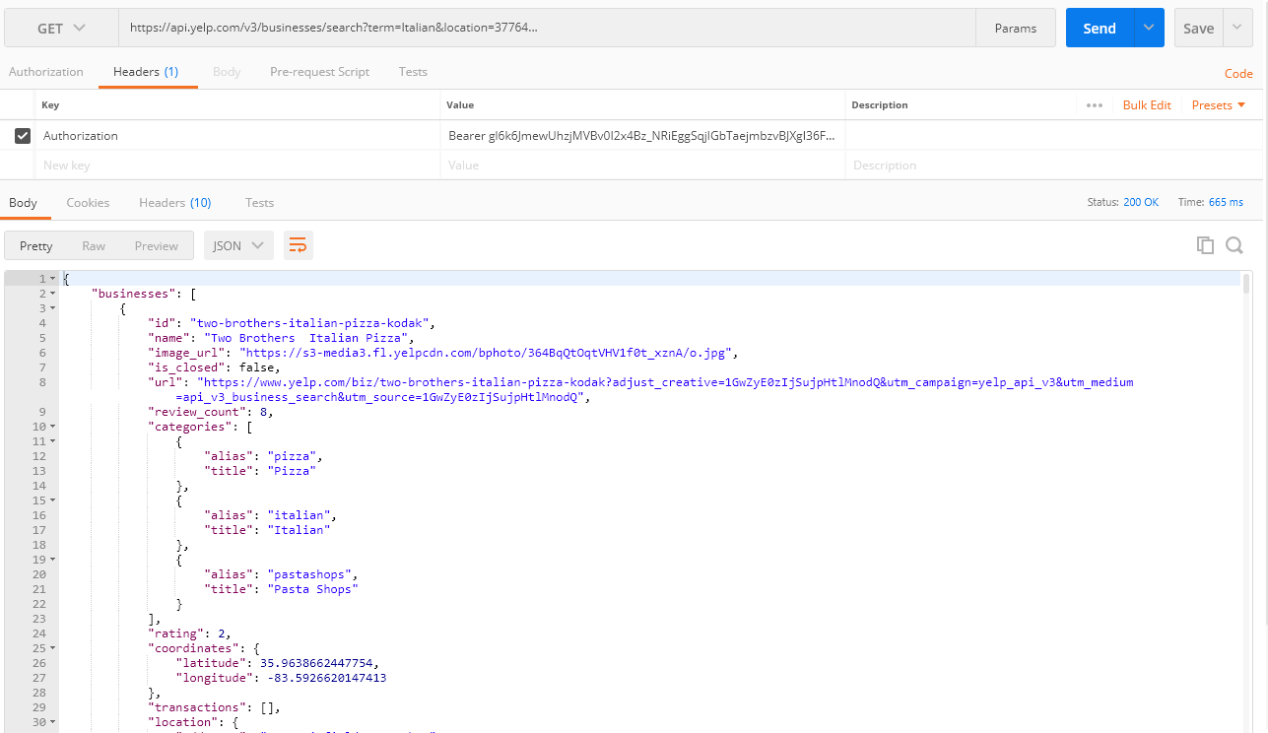
Pulling with Python
And each of these URLs holds a piece of our answer…

Slide 80
Step 6: Assemble and Clean the Data

Slide 81
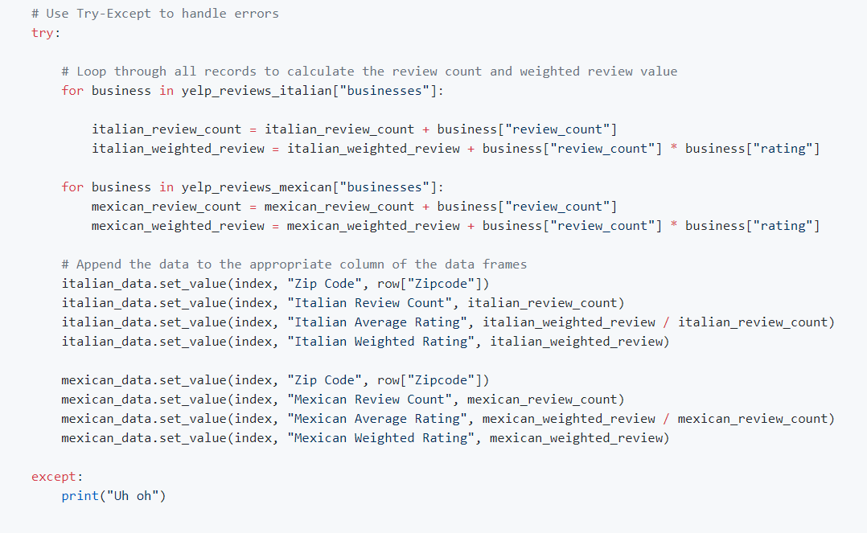
Pulling with Python
This funky code…

Slide 82
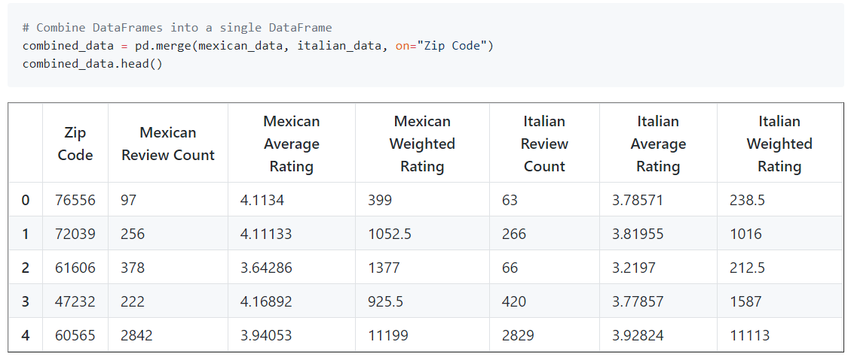
Cleaning with Pandas
No data comes out intrinsically the way you want it to.
In our case, we needed multiple steps to aggregate the data along our channels of interest.

Slide 83
Step 7: Analyze for Trends

Slide 84
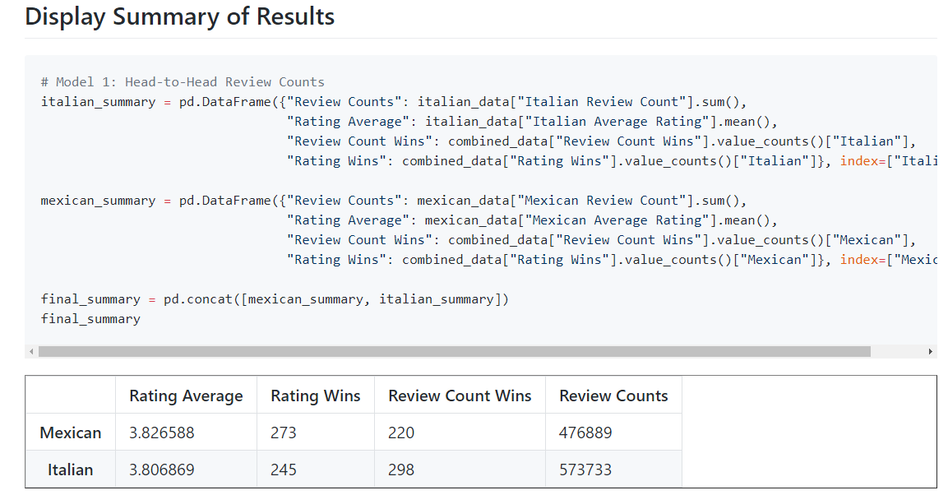
Analyze for Trends (Table)
Ugh..
It’s Close.

Slide 85
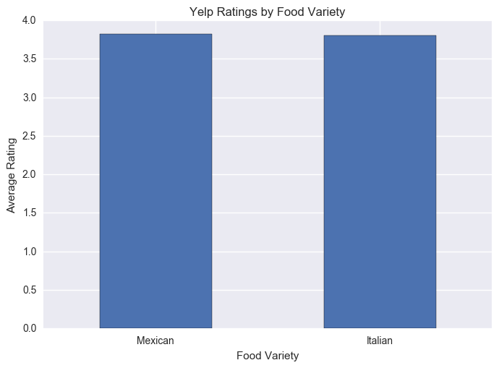
Analyze for Trends (Ratings)
Yelpers Rate Italian and Mexican relatively equally.

Slide 86
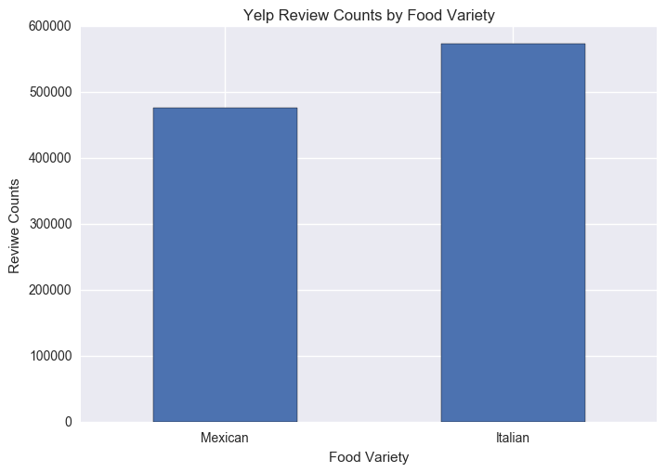
Analyze for Trends (Review Counts)
But… Yelpers seem to significantly review more Italian restaurants.

Slide 87
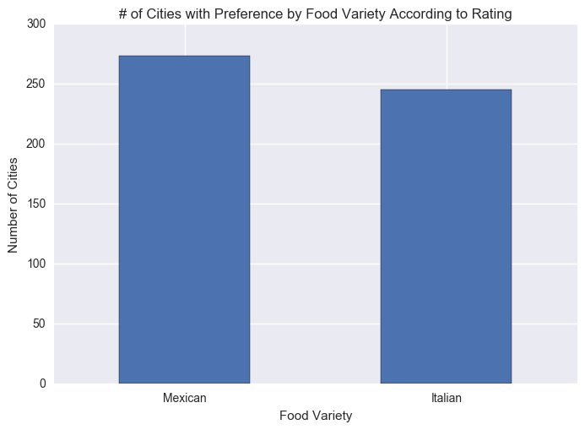
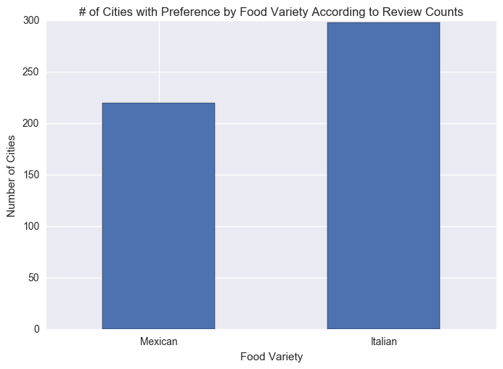
Analyze for Trends (Winner Take All)
Just for kicks I threw in an analysis to ask based on aggregating the data along cities using a “Winner-Take-All” approach.
It’s sort of a wash.

Slide 88
Analyze for Trends (Statistical Analysis)
Metric | Italian | Mexican | p-Value (T-Test)
Average Rating | 3.806 | 3.826 | 0.284
Review Counts | 573k | 476k | 0.057
Because of how close the numbers appear, we utilized a Student’s T-Test to quickly assess if the perceived differences are statistically significant.
The difference in review count is statistically significant.

Slide 89
Step 8: Acknowledge Limitations

Slide 90
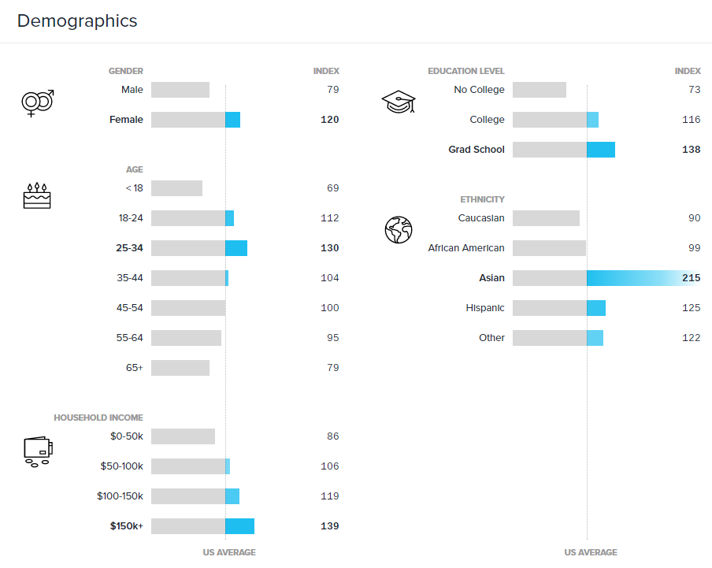
Limitations in Analysis
Yelp demographics may not match the American demographic.

Slide 91
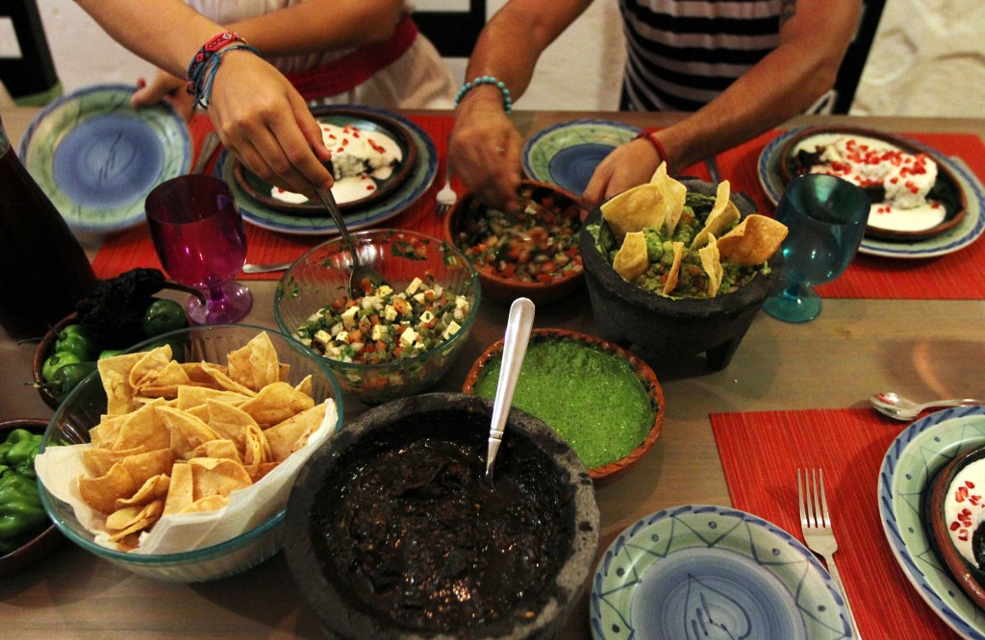

Limitations in Analysis
Restaurant experiences do not equate to home cooked meals.

Slide 92

Limitations in Analysis
“Fine” dining effect?

Slide 93
Step 9: Make the Call

Slide 94
Making the Call
The “Proper” Conclusion:
“Based on our analysis, it is clear that the American preference for Italian and Mexican food are similar in nature. As a whole, Americans rate Mexican and Italian restaurants at statistically similar scores (Avg. score: 3.8, p-value: 0.285). However, there exists statistically significant evidence that Americans write more reviews of Italian restaurants than Mexican (+96k, p-value: 0.057). This may indicate that there is an increased interest in visiting Italian restaurants at an experiential level. However, it may also merely suggest that Yelp users enjoy writing reviews on Italian restaurants more than Mexican restaurants.”

Slide 95
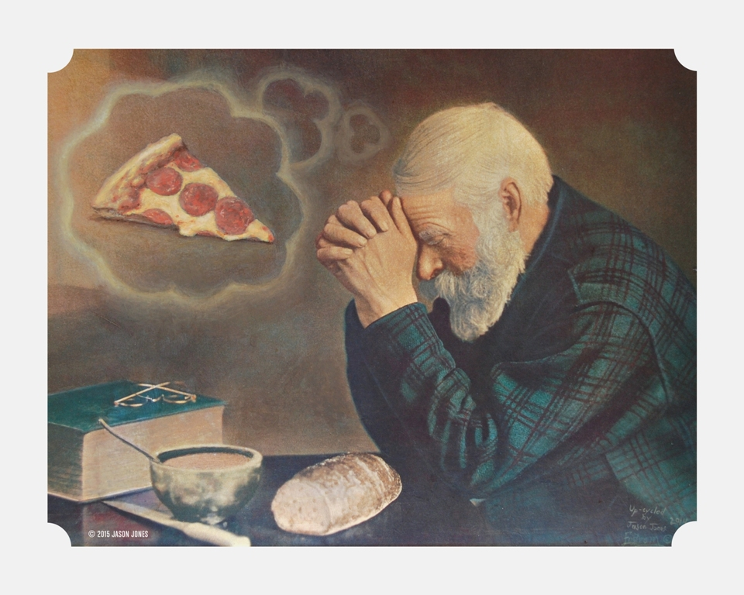
Making the Call
The “Let’s Be Real” Conclusion:
Italian.
(But it’s going to be close…)

Slide 96
> YOUR TURN!
Activity: Analyze the Code | Suggested Time: 10 min
Assignment:
Take a few moments to analyze the code provided over slack. Talk to the people in your group and try to dissect as much (or as little) as you can.
If you are new to coding, your goal should be to understand what a single line does.
If you are not new to coding, your goal should be to understand the overall flow of activities.
Take a moment to explain what you’ve learned to the people around you.

Slide 97

Freaked Out a Bit?
It’s okay!

Slide 98
An Analytics Paradigm
Notes:
It’s important to keep in mind why you joined this class. Let’s talk about your goals.

Slide 99
Analytics Paradigm
Decompose the Ask
Identify Data Sources
Define Strategy and Metrics
Build Data Retrieval Plan
Retrieve the Data
Assemble and Clean
Analyze for Trends
Acknowledge Limitations
Make the Call or
Tell the Story
Regardless of type or industry, this paradigm provides a repeatable pathway for effective data problem solving.

Slide 100
Thought Experiment #2
Predicting Gentrification
Notes:
It’s important to keep in mind why you joined this class. Let’s talk about your goals.

Slide 101

Let’s Talk Gentrification

Slide 102
> YOUR TURN!
Activity: Predicting Gentrification | Suggested Time: 10 min
Assignment:
Using the Analytics Paradigm as a framework, outline a strategy by which you would identify which neighborhoods in our city are seeing signs of gentrification?
Specifically, how would you answer the questions:
What observable signs can we detect to suggest gentrification is happening?
What means can we use to determine how long the trend has been happening?
What “proxies” might we use to identify gentrification in non-obvious ways?
How might you create a visualization of this data to best “tell the story”?
Pay special attention to details like:
What data will you use to build your “model”?
How will you retrieve the data?
What does your final “story” look like?

Slide 103
Prepare for Next Class
Notes:
It’s important to keep in mind why you joined this class. Let’s talk about your goals.

Slide 104
Prepare for Next Class
By Next Class:
Make certain that you have Microsoft Excel installed.
Make certain that you have Slack installed and are actively looking at it.
Figure out where the Git repository for our class is.
Figure out where class videos will be posted.

Slide 105
Homework #1
Notes:
It’s important to keep in mind why you joined this class. Let’s talk about your goals.

Slide 106

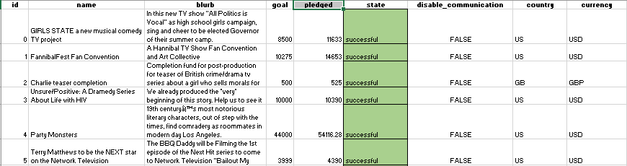
Homework #1 - Introduction
More information to come on Wednesday!

Slide 107
Questions / Discussion
Notes:
It’s important to keep in mind why you joined this class. Let’s talk about your goals.

Slide 108
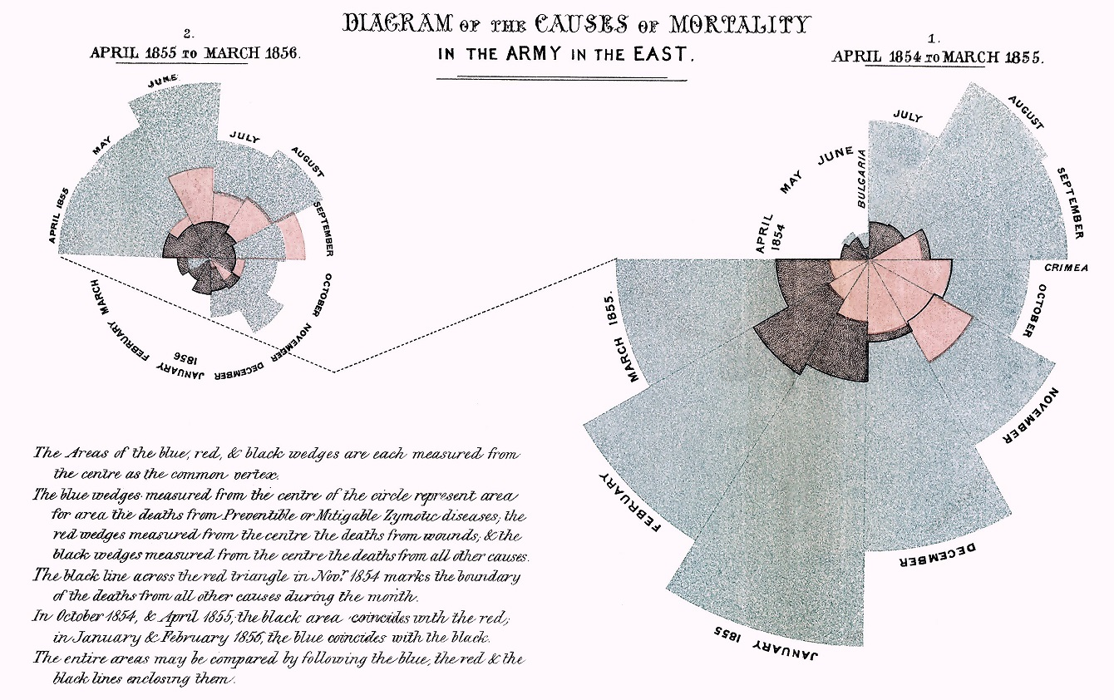
Data As… Story-Telling

Slide 109
Data As… Story-Telling
Data = Drama

